Slide 1
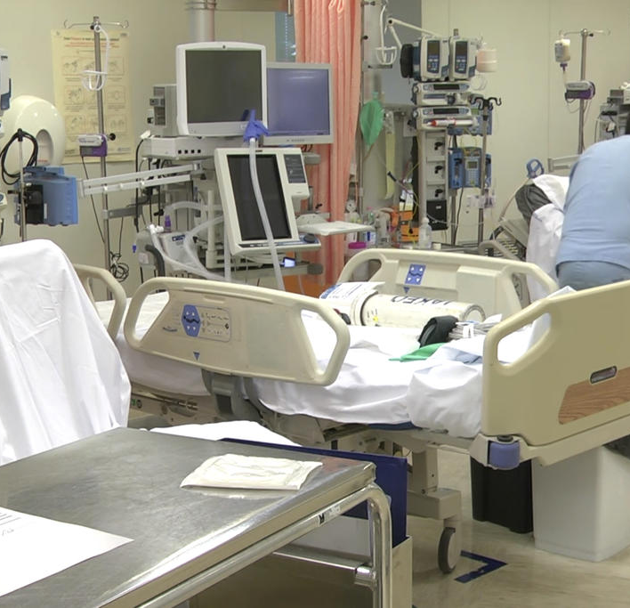
OPTIMAL CONTROL STRATEGIES TO PREVENT THE HOSPITAL BEDS COLLAPSE
DURING COVID-19 OUTBREAK

Slide 2
SUMMARY
Mathematical model presentation
Model fitting: motivations and cost function
Optimal control: motivations and strategies
Pontryagin’s maximum principle: theorem and application on the model
Results: fitting simulation
Results: optimal control solutions and evolutions comparison
Conclusions

Slide 3
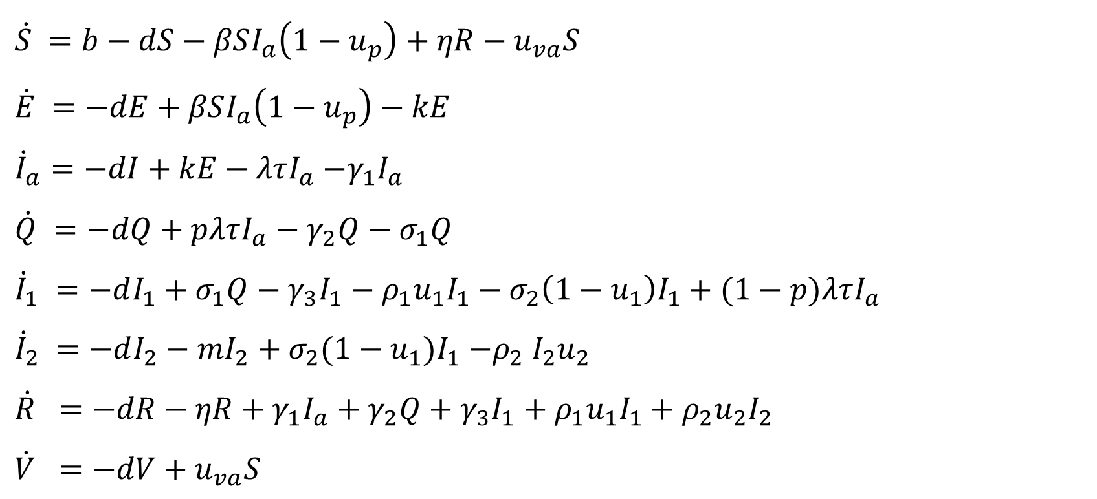
MATHEMATIC MODEL: STATE EQUATIONS WITH CONTROL
$$\dot{S} =b−dS−βSI_{a}\left(1−u_{p}\right)+ηR−u_{va}S$$
$$\dot{E} =−dE+βSI_{a}\left(1−u_{p}\right)−kE$$
${\dot{I}}_{a}=−dI+kE−λτI_{a}$ $−γ_{1}I_{a}$
$\dot{Q} =−dQ+pλτI_{a}−γ_{2}Q−$ $σ_{1}Q$
${\dot{I}}_{1} =−dI_{1}+σ_{1}Q−γ_{3}I_{1}−ρ_{1}u_{1}I_{1}−σ_{2}\left(1−u_{1}\right)I_{1}+(1−p)λτI_{a}$
$${\dot{I}}_{2} =−dI_{2}−mI_{2}+σ_{2}(1−u_{1})I_{1}{−ρ}_{2}I_{2}u_{2}$$
$$\dot{R} =−dR−ηR+γ_{1}I_{a}+γ_{2}Q+γ_{3}I_{1}+ρ_{1}u_{1}I_{1}+ρ_{2}u_{2}I_{2}$$
$$\dot{V} =−dV+u_{va}S$$

Slide 4





















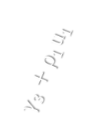

COMPARTMENTS DEFINITION
$$S$$ | Susceptible
$$E$$ | Exposed
$$I_{a}$$ | Infected Undetected
$$Q$$ | Quarantined
$$I_{1}$$ | Hospitalized infected non-IC-u
$$I_{2}$$ | Hospitalized infected IC-u
$$R$$ | Recovered
$$V$$ | Vaccinated
$$b$$
$$V$$
$$u_{va}$$
$$S$$
$$βI_{a}\left(1−u_{p}\right)$$
$$E$$
$$k$$
$$I_{a}$$
$$η$$
$$(1−p)λτ$$
$$pλτ$$
$$m$$
$$Q$$
$$σ_{1}$$
$$I_{1}$$
$$σ_{2}(1−u_{1})$$
$$I_{2}$$
$$ρ_{2}u_{2}$$
$$γ_{3}+ρ_{1}u_{1}$$
$$γ_{2}$$
$$R$$
$$γ_{1}$$
Notes:
$$S$$
people who are not yet infected but they are potentially plagued by the virus.
$$E$$
people who have been infected but they still cannot spread the virus because of the incubation period.
$$I_{a}$$
fraction of population that can infect the susceptible class because they are not yet detected and so they could have contacts with susceptible people.
$$Q$$
fraction of population detected with or without symptoms quarantined and due to this fact, they cannot have contact with susceptible.
$$I_{1}$$
fraction of population detected, with symptoms and hospitalized not in Intensive Care (IC)
$$I_{2}$$
fraction of population detected that due to the heavy symptoms has been hospitalized in Intensive Care (IC).
$$R$$
fraction of population healed from the virus and temporarily immune.
$$V$$
fraction of population vaccinated and immune.

Slide 5
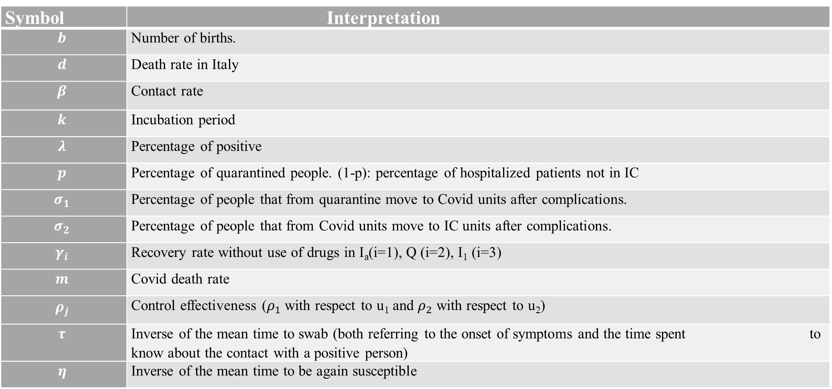
MODEL: PARAMETERS INTERPRETATION
Symbol | Interpretation
$$b$$ | Number of births.
$$d$$ | Death rate in Italy
$$β$$ | Contact rate
$$k$$ | Incubation period
$$λ$$ | Percentage of positive
$$p$$ | Percentage of quarantined people. (1-p): percentage of hospitalized patients not in IC
$$σ_{1}$$ | Percentage of people that from quarantine move to Covid units after complications.
$$σ_{2}$$ | Percentage of people that from Covid units move to IC units after complications.
$$γ_{i}$$ | Recovery rate without use of drugs in I_{a}(i=1), Q (i=2), I₁ (i=3)
$$m$$ | Covid death rate
$$ρ_{j}$$ | Control effectiveness ($ρ_{1}$ with respect to u₁ and $ρ_{2}$ with respect to u₂)
$$τ$$ | Inverse of the mean time to swab (both referring to the onset of symptoms and the time spent to know about the contact with a positive person)
$$η$$ | Inverse of the mean time to be again susceptible

Slide 6
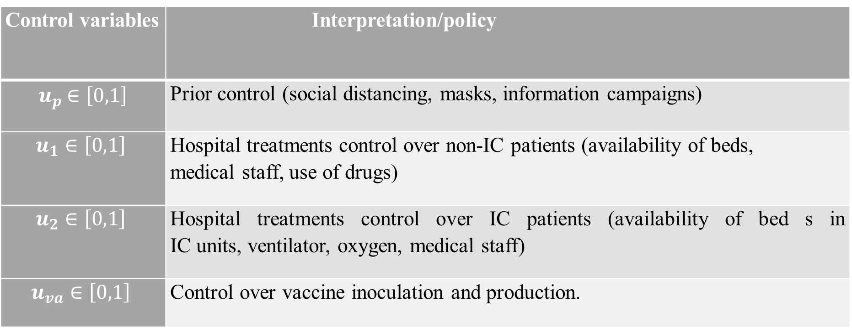
MODEL: CONTROL ACTIONS INTERPRETATION
Control variables | Interpretation/policy
$u_{p}$ $∈\left[0,1\right]$ | Prior control (social distancing, masks, information campaigns)
$$u_{1}∈\left[0,1\right]$$ | Hospital treatments control over non-IC patients (availability of beds, medical staff, use of drugs)
$$u_{2}∈\left[0,1\right]$$ | Hospital treatments control over IC patients (availability of bed s in IC units, ventilator, oxygen, medical staff)
$$u_{va}∈\left[0,1\right]$$ | Control over vaccine inoculation and production.
Notes:
We consider four different way to control the system:
With $u_{p},u_{1}∈\left[0,1\right],$ $u_{2}∈\left[0,1\right],$ $u_{va}∈\left[0,1\right]$

Slide 7
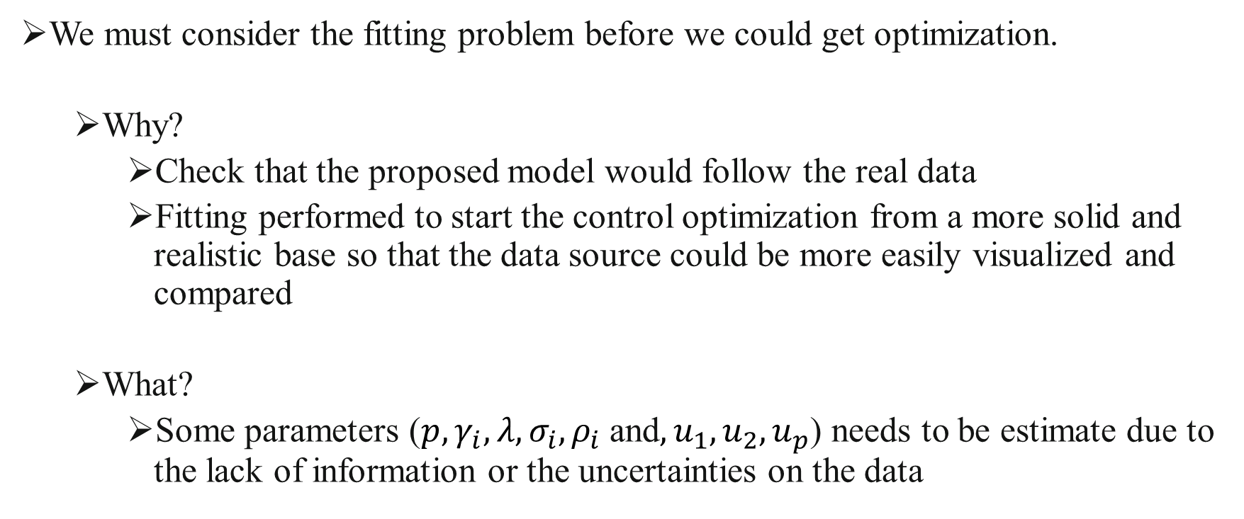
MODEL FITTING
We must consider the fitting problem before we could get optimization.
Why?
Check that the proposed model would follow the real data
Fitting performed to start the control optimization from a more solid and realistic base so that the data source could be more easily visualized and compared
What?
Some parameters ($p,γ_{i},λ,σ_{i},ρ_{i}$ and$,u_{1},u_{2},u_{p}$) needs to be estimate due to the lack of information or the uncertainties on the data
Notes:
Aim: check that the proposed model would follow the real data and find the parameters that would reproduce the real behaviour
Some parameters ($p,γ_{i},λ,σ_{i},ρ_{i}$ plus the base control applied by the government $u_{va},u_{1},u_{2},u_{p}$) has been estimated due to the lack of information and the uncertainties on the data
Fitting performed to start the control optimization from a more solid and realistic base so that the data source could be more easily visualized and compared

Slide 8
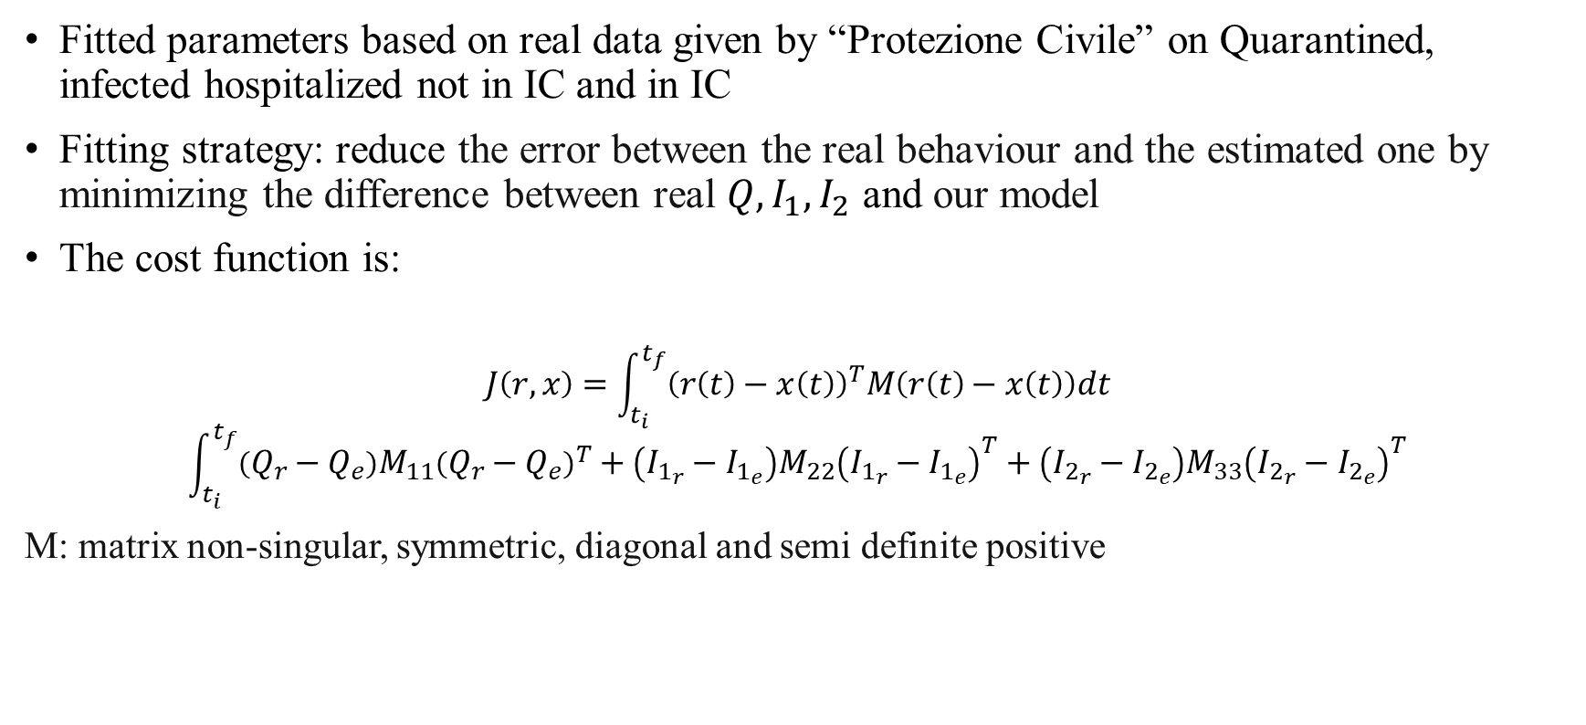
FITTING STRATEGY AND OBJECTIVE FUNCTION DEFINITION
Fitted parameters based on real data given by “Protezione Civile” on Quarantined, infected hospitalized not in IC and in IC
Fitting strategy: reduce the error between the real behaviour and the estimated one by minimizing the difference between real $Q,I_{1},I_{2}$ and our model
The cost function is:
$$J\left(r,x\right)=\int_{t_{i}}^{t_{f}}{{\left(r\left(t\right)−x\left(t\right)\right)}^{T}M\left(r\left(t\right)−x\left(t\right)\right)dt}$$
$$\int_{t_{i}}^{t_{f}}{\left(Q_{r}−Q_{e}\right){M_{11}\left(Q_{r}−Q_{e}\right)}^{T}+\left(I_{1_{r}}−I_{1_{e}}\right)M_{22}{\left(I_{1_{r}}−I_{1_{e}}\right)}^{T}+\left(I_{2_{r}}−I_{2_{e}}\right)M_{33}{\left(I_{2_{r}}−I_{2_{e}}\right)}^{T}}$$
M: matrix non-singular, symmetric, diagonal and semi definite positive

Slide 9
OPTIMAL CONTROL : MOTIVATIONS AND STRATEGIES
Find a way to avoid the spread of the virus
Prevent hospitals overcrowding and beds collapse in IC-u avoiding number of deaths
Four strategies proposed:
Maximise the number of susceptible (S)
Minimise hospitalised patients in IC (I₂) and hospitalised ones with symptoms not in IC (I₁)
Maximise susceptible (S) and minimise hospitalised patients in IC (I₂) and hospitalised ones with symptoms not in IC (I₁)
Maximise the number of vaccinated subjects (V)

Slide 10
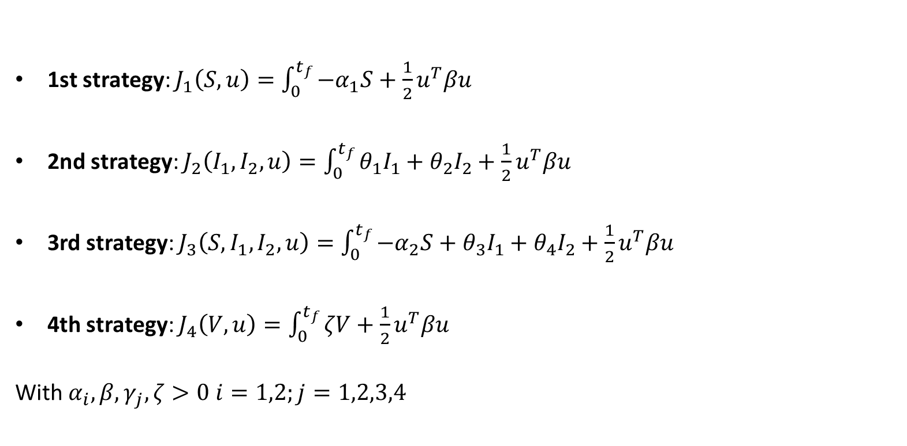
COST FUNCTIONS
1st strategy: $J_{1}\left(S, u\right)=\int_{0}^{t_{f}}{{−α}_{1}S+{\frac{1}{2}u}^{T}βu}$
2nd strategy: $J_{2}\left(I_{1},I_{2},u\right)=\int_{0}^{t_{f}}{θ_{1}I_{1}+θ_{2}I_{2}+{\frac{1}{2}u}^{T}βu}$
3rd strategy: $J_{3}\left(S,I_{1},I_{2},u\right)=\int_{0}^{t_{f}}{{−α}_{2}S+θ_{3}I_{1}+θ_{4}I_{2}+{\frac{1}{2}u}^{T}βu}$
4th strategy: $J_{4}\left(V,u\right)=\int_{0}^{t_{f}}{ζV+\frac{1}{2}u^{T}βu}$
With $α_{i},β,γ_{j},ζ>0 i=1,2;j=1,2,3,4$
Notes:
Each one of the four strategies described above corresponds to a different cost functinon:

Slide 11
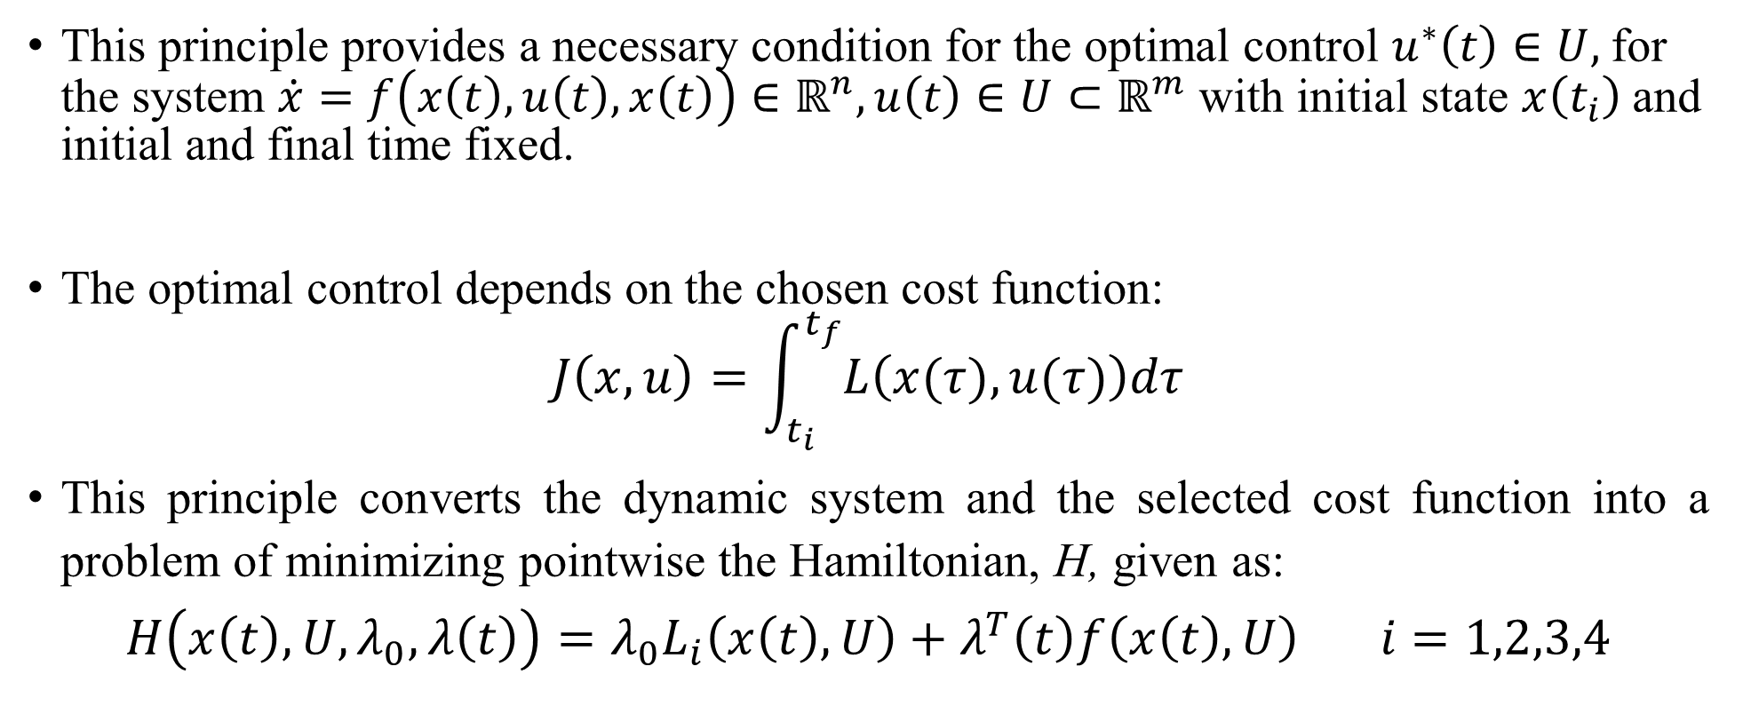
OPTIMAL CONTROL PROBLEM AND SOLUTIONS: PONTRYAGIN MAXIMUM PRINCIPLE
This principle provides a necessary condition for the optimal control $u^{∗}\left(t\right)∈U,$for the system $\dot{x}=f\left(x\left(t\right), u\left(t\right),x\left(t\right)\right)∈ℝ^{n}, u\left(t\right)∈U⊂ℝ^{m}$ with initial state $x\left(t_{i}\right)$and initial and final time fixed.
The optimal control depends on the chosen cost function:
$$J\left(x,u\right)=\int_{t_{i}}^{t_{f}}{L\left(x(τ),u(τ)\right)dτ}$$
This principle converts the dynamic system and the selected cost function into a problem of minimizing pointwise the Hamiltonian, H, given as:
$$H\left(x\left(t\right),U,λ_{0},λ\left(t\right)\right)=λ_{0}L_{i}\left(x\left(t\right),U\right)+λ^{T}\left(t\right)f\left(x\left(t\right),U\right) i=1,2,3,4$$

Slide 12
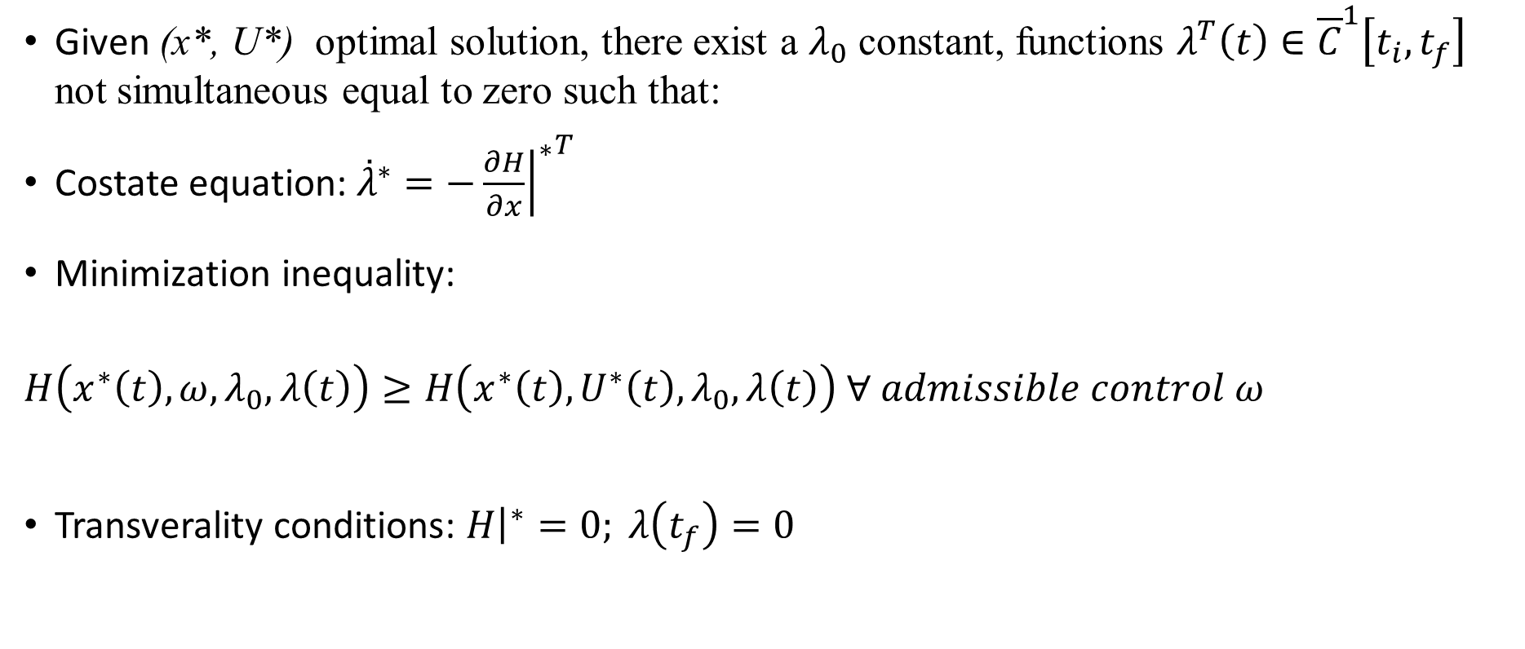
PONTRYAGIN MAXIMUM PRINCPLE: THEOREM
Given (x*, U*) optimal solution, there exist a $λ_{0}$ constant, functions $λ^{T}\left(t\right)∈{\overline{C}}^{1}\left[t_{i},t_{f}\right]$ not simultaneous equal to zero such that:
Costate equation: ${\overset{˙}{λ}}^{∗}=−{{\left.\frac{∂H}{∂x}\right|}^{∗}}^{T}$
Minimization inequality:
$H\left(x^{∗}\left(t\right),ω,λ_{0},λ\left(t\right)\right)≥H\left(x^{∗}\left(t\right),U^{∗}\left(t\right),λ_{0},λ\left(t\right)\right) ∀ admissible control ω$
Transverality conditions: ${\left.H\right|}^{∗}=0; λ\left(t_{f}\right)=0$

Slide 13
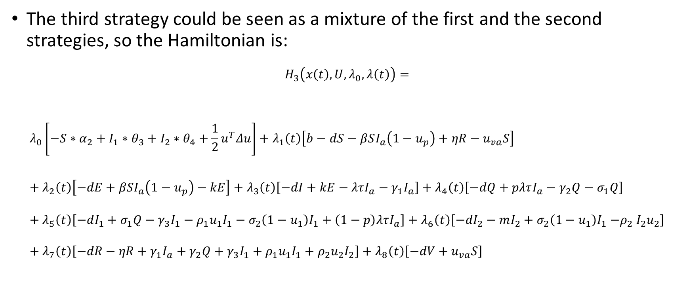
APPLICATION OF THE PRINCIPLE TO THE STRATEGIES: HAMILTONIAN
The third strategy could be seen as a mixture of the first and the second strategies, so the Hamiltonian is:
$$H_{3}\left(x\left(t\right),U,λ_{0},λ\left(t\right)\right)=$$
$$λ_{0}\left[−S∗α_{2}+I_{1}∗θ_{3}+I_{2}∗θ_{4}+{\frac{1}{2}u}^{T}Δu\right]+λ_{1}\left(t\right)\left[b−dS−βSI_{a}\left(1−u_{p}\right)+ηR−u_{va}S\right]+λ_{2}\left(t\right)\left[−dE+βSI_{a}\left(1−u_{p}\right)−kE\right]+λ_{3}\left(t\right)\left[−dI+kE−λτI_{a}−γ_{1}I_{a}\right]+λ_{4}\left(t\right)\left[−dQ+pλτI_{a}−γ_{2}Q−σ_{1}Q\right]+λ_{5}\left(t\right)\left[−dI_{1}+σ_{1}Q−γ_{3}I_{1}−ρ_{1}u_{1}I_{1}−σ_{2}\left(1−u_{1}\right)I_{1}+\left(1−p\right)λτI_{a}\right]+λ_{6}\left(t\right)\left[−dI_{2}−mI_{2}+σ_{2}\left(1−u_{1}\right)I_{1}{−ρ}_{2}I_{2}u_{2}\right]+λ_{7}\left(t\right)\left[−dR−ηR+γ_{1}I_{a}+γ_{2}Q+γ_{3}I_{1}+ρ_{1}u_{1}I_{1}+ρ_{2}u_{2}I_{2}\right]+λ_{8}\left(t\right)\left[−dV+u_{va}S\right]$$

Slide 14


APPLICATION OF THE PRINCIPLE TO THE STRATEGIES: COSTATE EQUATIONS
From the first condition about the costate equations ${\overset{˙}{λ}}^{∗}=−{{\left.\frac{∂H}{∂x}\right|}^{∗}}^{T}$, for the third cost function we have the following results:
$$\frac{∂λ_{1}}{∂t}=\frac{−∂H_{3}}{∂S}=λ_{8}u_{v}−α_{2}−λ_{1}\left(d_{1}+u_{v}−I_{a}β\left(u_{p}−1\right)\right)−I_{a}βλ_{2}\left(u_{p}−1\right)$$
$$\frac{∂λ_{2}}{∂t}=\frac{−∂H_{3}}{∂E}=kλ_{3}−λ_{2}\left(d_{2}+k\right)$$
$$\frac{∂λ_{3}}{∂t}=\frac{−∂H_{3}}{∂I_{a}}=γ_{1}λ_{7}−λ_{3}\left(d_{3}+γ_{1}+λτ\right)+λλ_{4}pτ+Sβλ_{1}\left(u_{p}−1\right)−Sβλ_{2}\left(u_{p}−1\right)−λλ_{5}τ\left(p−1\right)$$
$$\frac{∂λ_{4}}{∂t}=\frac{−∂H_{3}}{∂Q}=γ_{2}λ_{7}+λ_{5}σ_{1}−λ_{4}\left(d_{4}+γ_{2}+σ_{1}\right)$$
$$\frac{∂λ_{5}}{∂t}=\frac{−∂H_{3}}{∂I_{1}}=θ_{3}+λ_{7}\left(γ_{3}+ρ_{1}u_{1}\right)−λ_{5}\left(d_{5}+γ_{3}+ρ_{1}u_{1}−σ_{2}\left(u_{1}−1\right)\right)−λ_{6}σ_{2}\left(u_{1}−1\right)$$
$$\frac{∂λ_{6}}{∂t}=\frac{−∂H_{3}}{∂I_{2}}=θ_{4}−λ_{6}\left(d_{6}+m+ρ_{2}u_{2}\right)+λ_{7}ρ_{2}u_{2}$$
$$\frac{∂λ_{7}}{∂t}=\frac{−∂H_{3}}{∂R}=ηλ_{1}−λ_{7}\left(d_{7}+η\right)$$
$$\frac{∂λ_{8}}{∂t}=\frac{−∂H_{3}}{∂V}=−d_{8}λ_{8}$$

Slide 15
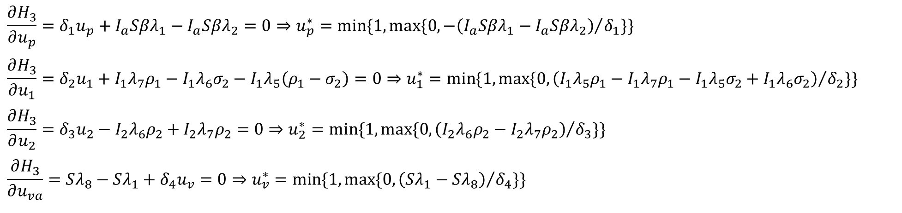
APPLICATION OF THE PRINCIPLE TO THE STRATEGIES: CONTROLS’ EXPRESSIONS
Controls’ Expressions are obtained as if they were defined in an open set, then, saturating the results:
Analogously for the other three strategies.
$$\frac{∂H_{3}}{∂u_{p}}=δ_{1}u_{p}+I_{a}Sβλ_{1}−I_{a}Sβλ_{2}=0⇒u_{p}^{∗}=min⁡\{1,max⁡\{0,{−\left(I_{a}Sβλ_{1}−I_{a}Sβλ_{2}\right)}/{δ_{1}\}\} }$$
$$\frac{∂H_{3}}{∂u_{1}}=δ_{2}u_{1}+I_{1}λ_{7}ρ_{1}−I_{1}λ_{6}σ_{2}−I_{1}λ_{5}\left(ρ_{1}−σ_{2}\right)=0⇒u_{1}^{∗}={min⁡\{1,max⁡\{0,\left(I_{1}λ_{5}ρ_{1}−I_{1}λ_{7}ρ_{1}−I_{1}λ_{5}σ_{2}+I_{1}λ_{6}σ_{2}\right)}/{δ_{2}\}\}}$$
$$\frac{∂H_{3}}{∂u_{2}}=δ_{3}u_{2}−I_{2}λ_{6}ρ_{2}+I_{2}λ_{7}ρ_{2}=0⇒u_{2}^{∗}=min⁡\{1,max⁡\{0,{\left(I_{2}λ_{6}ρ_{2}−I_{2}λ_{7}ρ_{2}\right)}/{δ_{3}\}\} }$$
$$\frac{∂H_{3}}{∂u_{va}}=Sλ_{8}−Sλ_{1}+δ_{4}u_{v}=0⇒u_{v}^{∗}={min⁡\{1,max⁡\{0,\left(Sλ_{1}−Sλ_{8}\right)}/{δ_{4}\}\} }$$

Slide 16

RESULTS
In this section optimality is studied from a numerical point of view
We have used © Matlab and © Matlab Optimization Toolbox with the extensive help of the Fmincon function
Notes:
Fmincon definition: It allows the finding of a constrained minimum of a function of several variables in an iterative way by solving a sequence of approximate minimization problems.
To discuss the effects of the control strategy over the number of infected subjects in IC and not, we have considered the following initial states:
$$S\left(0\right)=59699728;E\left(0\right)=200000;I_{a}\left(0\right)=300000;Q\left(0\right)=17605;I_{1}\left(0\right)=1853;$$
$$I_{2}\left(0\right)=115;R\left(0\right)=200000;V\left(0\right)=0$$
They are solved by using the © Matlab Optimization Toolbox and the function fmincon

Slide 17
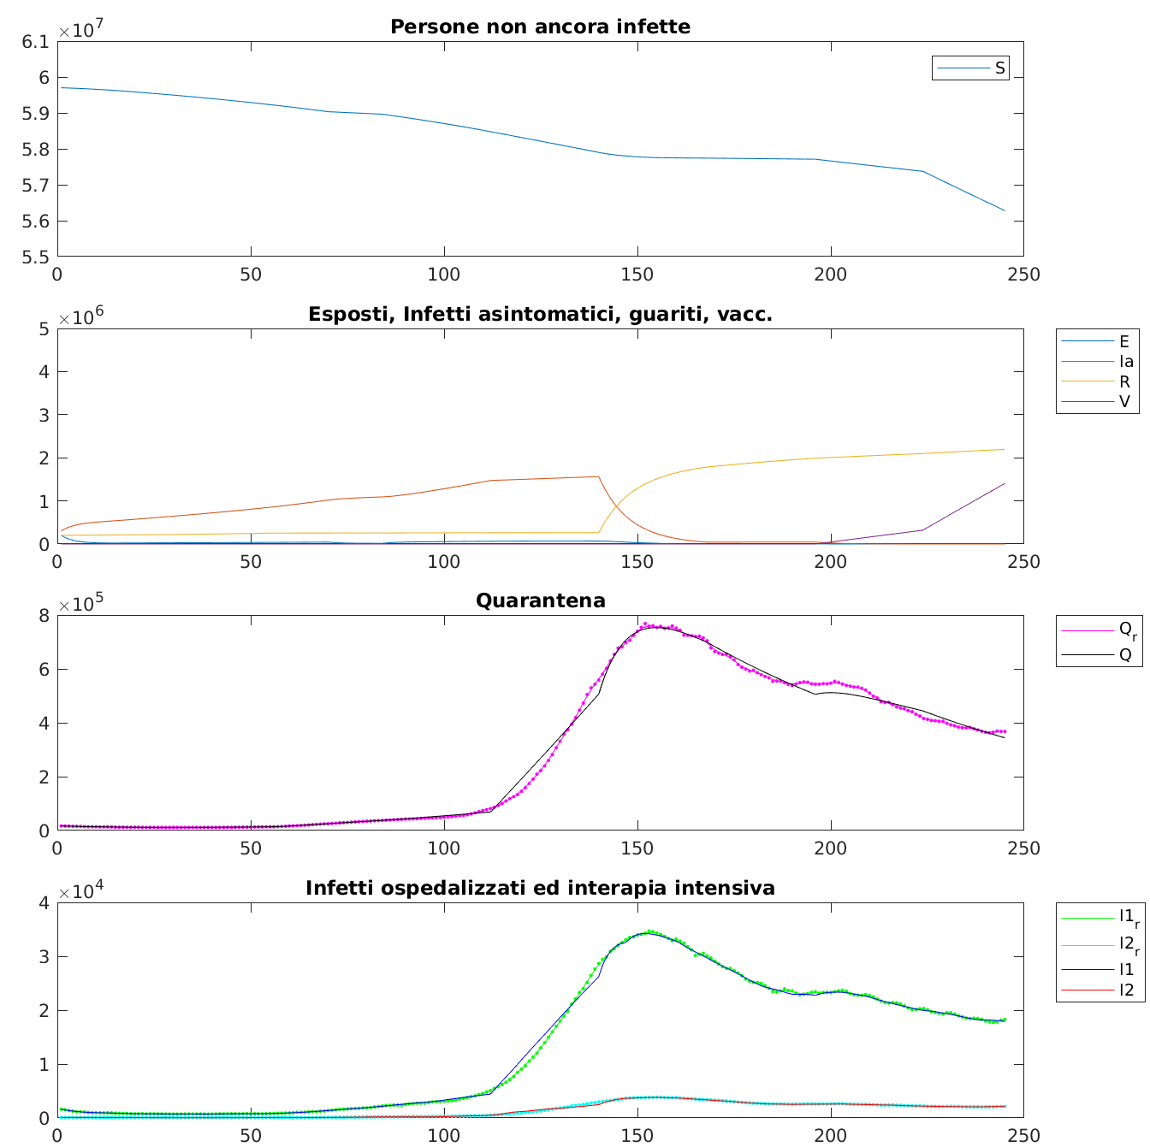
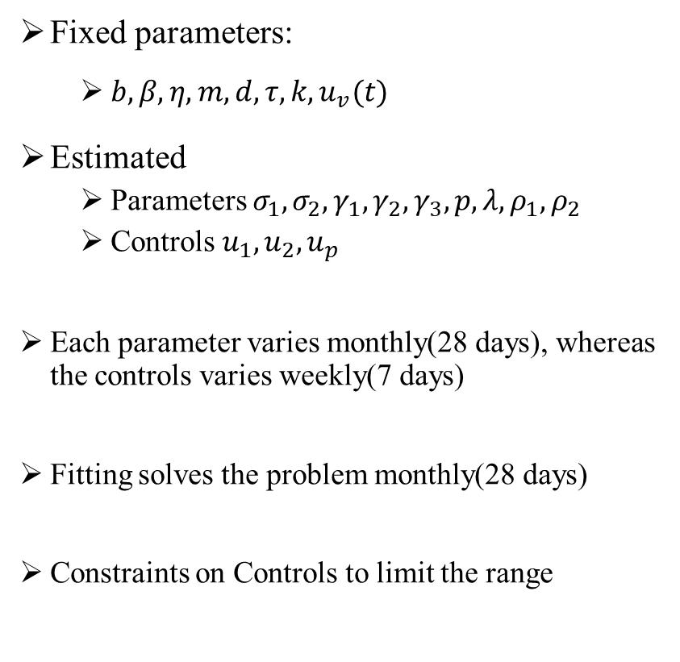
RESULTS: FITTING AND SIMULATION
Fixed parameters:
$b,β,η,m,d,τ,k,u_{v}(t)$
Estimated
Parameters $σ_{1},σ_{2},γ_{1},γ_{2},γ_{3},p,λ,ρ_{1},ρ_{2}$
Controls${ u}_{1},u_{2},u_{p}$
Each parameter varies monthly(28 days), whereas the controls varies weekly(7 days)
Fitting solves the problem monthly(28 days)
Constraints on Controls to limit the range
From 23rd June 2020 (t=0) to 22nd Feb 2021 (t=245)
Notes:
we have decided to give more importance to the fitting of the hospitalized not in IC and IC because of the more certain values given by those classes ($I_{1},I_{2})$.
B , beta, eta , m, d, k

Slide 18

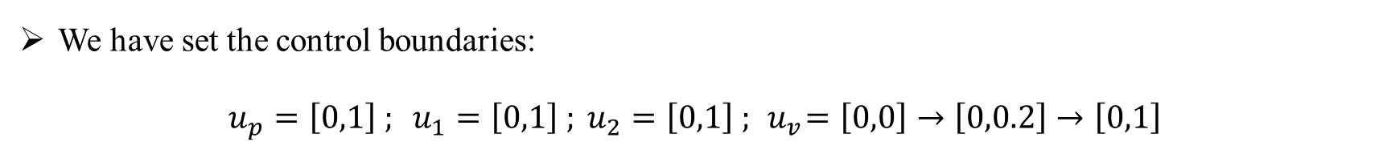

RESULTS: OPTIMAL CONTROL PRELIMINARIES
We have set the control boundaries:
$$u_{p}=\left[0,1\right] ; u_{1}=\left[0,1\right] ; u_{2}=\left[0,1\right] ; { u}_{v}=\left[0,0\right]→\left[0,0.2\right]→\left[0,1\right]$$
We have set the control guess for the optimization as follow:
$$u_{p}=1; u_{1}=0.3;u_{2}=0.1;u_{va}=0$$
We have decided to perform an optimal resources allocation with following constrain:
$$u_{p}+u_{1}+u_{2}+u_{va}<2.5$$
The optimization has been performed considering weekly variations of the control
Optimization considers the problem globally

Slide 19
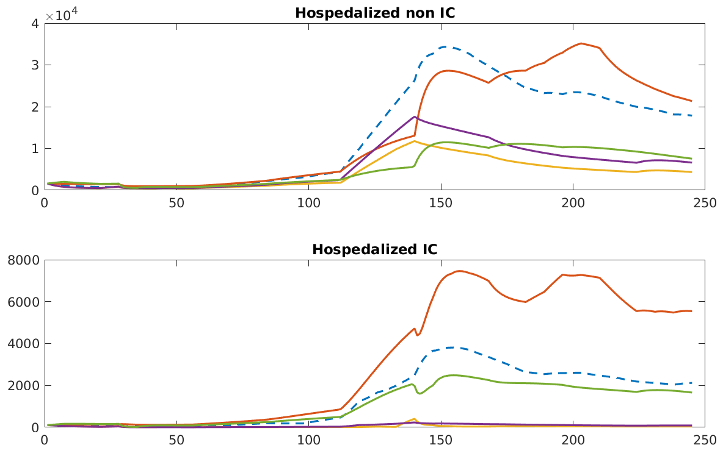
RESULTS: OPTIMAL STATE TRAJECTORIES
Fitting evolution
Maximize the number of susceptible
Minimize the number of Hospitalized in IC and not in IC
Maximize the number of susceptible and minimize the number of Hospitalized not IC and IC
Maximize the number of vaccinated people
Comparison of the incidence of opt strategies on the infected not in IC and infected in IC

Slide 20
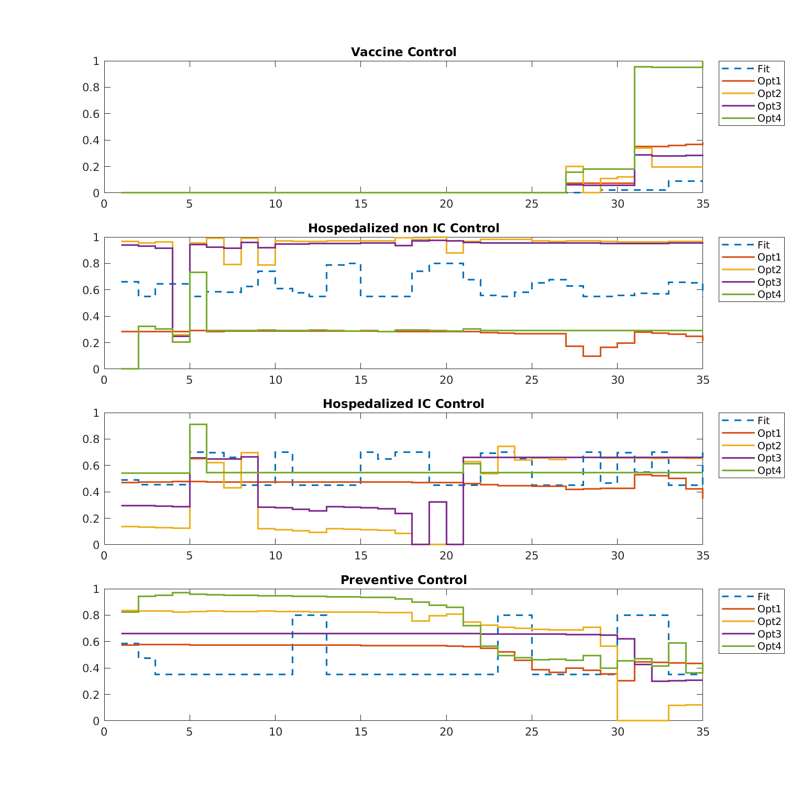
RESULTS OF OPTIMAL CONTROL STRATEGY:
CONTROLS COMPARISON
Fitting evolution
Maximize the number of susceptible
Minimize the number of Hospitalized in IC and not in IC
Maximize the number of susceptible and minimize the number of Hospitalized not IC and IC
Maximize the number of vaccinated people
Best Strategies
Higher Preventive control
Higher Hospitalized non IC control
Controls u_{p}(t) , u₁(t) , u₂(t) , u_{v}(t) comparison on a time interval of 35 weeks (245 days)

Slide 21
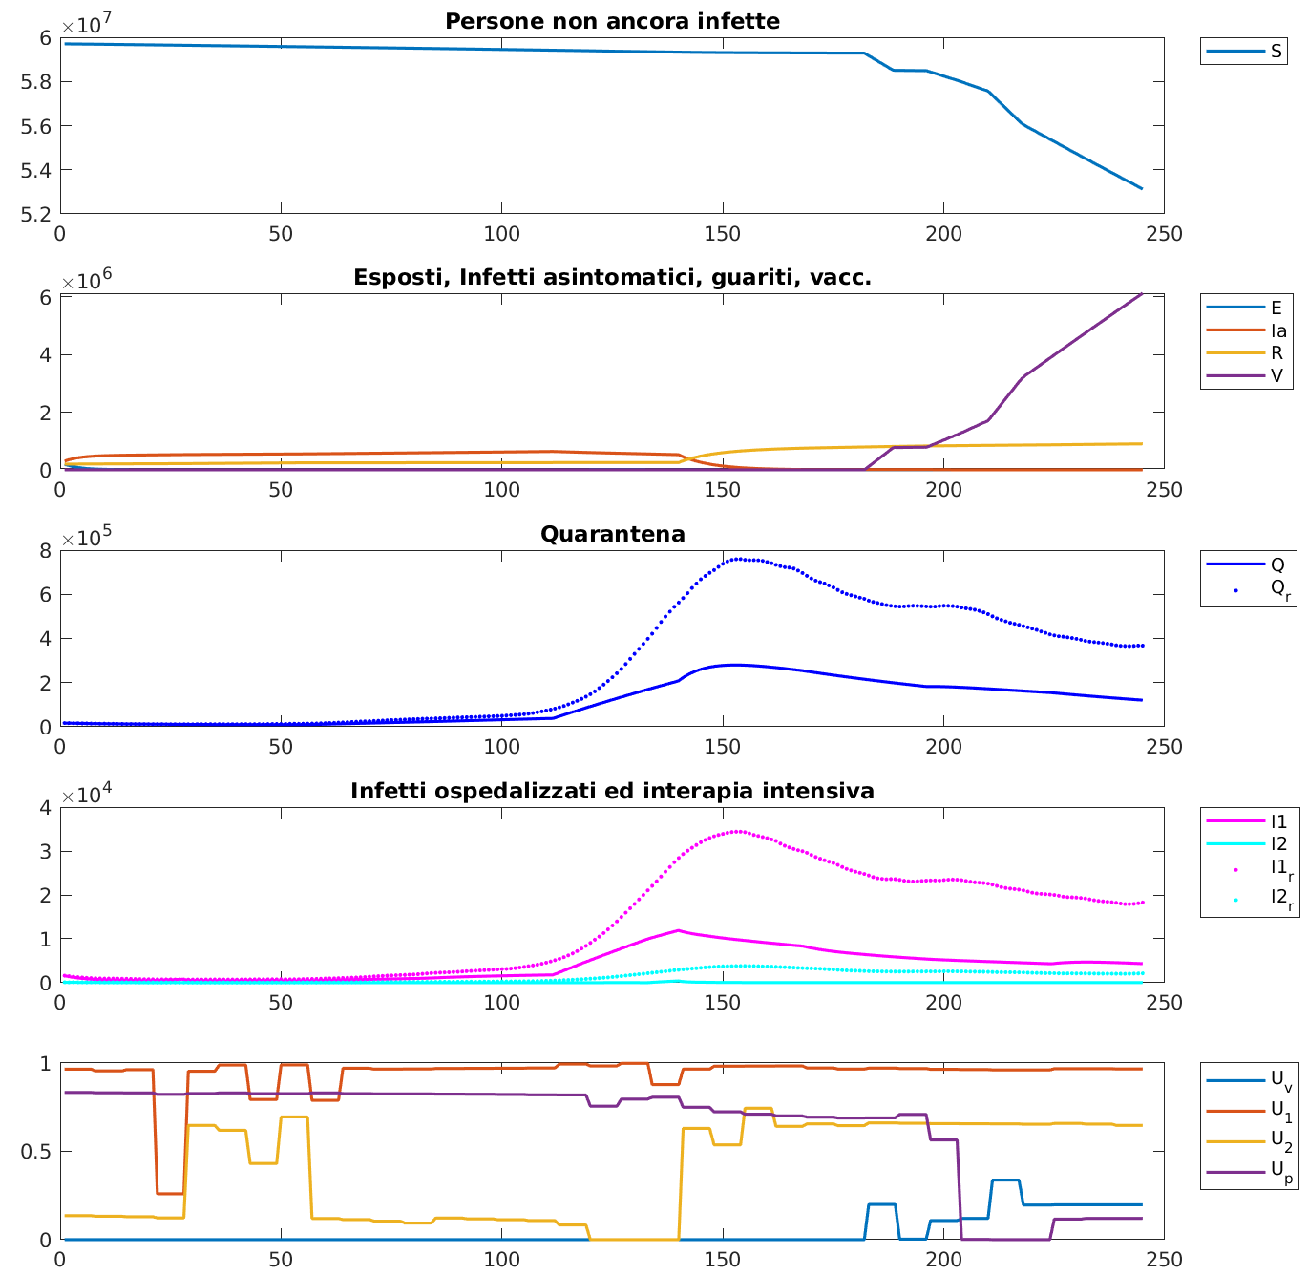
RESULTS : BEST STRATEGY OVERALL
2nd Strategy
Better on Quarantined
Better on Hospitalized
Better on IC-u
Controls u_{p}(t) , u₁(t) , u₂(t) , u_{v}(t) on a time interval of 35 weeks (245 days)

Slide 22
CONCLUSIONS
Carried out to face the problem of bed collapse and overcrowding in the hospital that affected Italy especially in the second wave
We have used optimal control theory to compute the control actions
We have decided to try different optimisation strategies to understand which strategy was the best in terms of numbers of infected hospitalised and in terms of control efforts
2nd and 3rd strategies are the best, and are the ones that directly includes the two compartments H and H-IC
Open topic: predict the dynamic system evolution and therefore act on the controls in time to prevent new epidemic waves and saturations of sanitary facilities.

